Slide 1
Database System
Development Lifecycle
Database Systems
Database Planning, Design, and Administration
Notes:
Database Systems (Spring 2011) - Naveed Anwer Butt @UOG

Slide 2
Objectives
Main components of an information system.
Main stages of database system development lifecycle.
Main phases of database design: conceptual, logical, and physical design.
Benefits of CASE tools.
How to evaluate and select a DBMS.
Distinction between data administration and database administration.
Purpose and tasks associated with data administration and database administration.
Notes:
September 98
2
Chapter Name

Slide 3
Objectives
How problems associated with software development led to the software crisis.
How the software crisis led to a structured approach to software development called the information systems lifecycle.
Notes:
September 98
2
Chapter Name

Slide 4
Objectives
About the relationship between the information systems lifecycle and the database system development lifecycle.
The stages of the database system development lifecycle.
The activities associated with each stage of the database system development lifecycle.
Notes:
September 98
2
Chapter Name

Slide 5
Software Depression
Last few decades have seen proliferation of software applications, many requiring constant maintenance involving:
  correcting faults,
  implementing new user requirements,
  modifying software to run on new or upgraded platforms.
Effort spent on maintenance began to absorb resources at an alarming rate.

Slide 6
Software Depression
As a result, many major software projects were
  late,
  over budget,
  unreliable,
  difficult to maintain,
  performed poorly.
In late 1960s, led to ‘software crisis’, now refer to as the ‘software depression’.

Slide 7
Software Depression
Major reasons for failure of software projects includes:
- lack of a complete requirements specification;
- lack of appropriate development methodology;
- poor decomposition of design into manageable components.
Structured approach to development was proposed called Information Systems Lifecycle (ISLC).

Slide 8
Information System
Resources that enable collection, management, control, and dissemination of information throughout an organization.
Database is fundamental component of IS, and its development/usage should be viewed from perspective of the wider requirements of the organization.

Slide 9
SDLC (System Development Life Cycle)
A traditional process for conducting an information systems development project is called the system development life cycle (SDLC). The SDLC is a complete set of steps that a team of information systems professionals, including database designers and programmers, follow in an organization to specify, develop, maintain, and replace information systems.

Slide 10
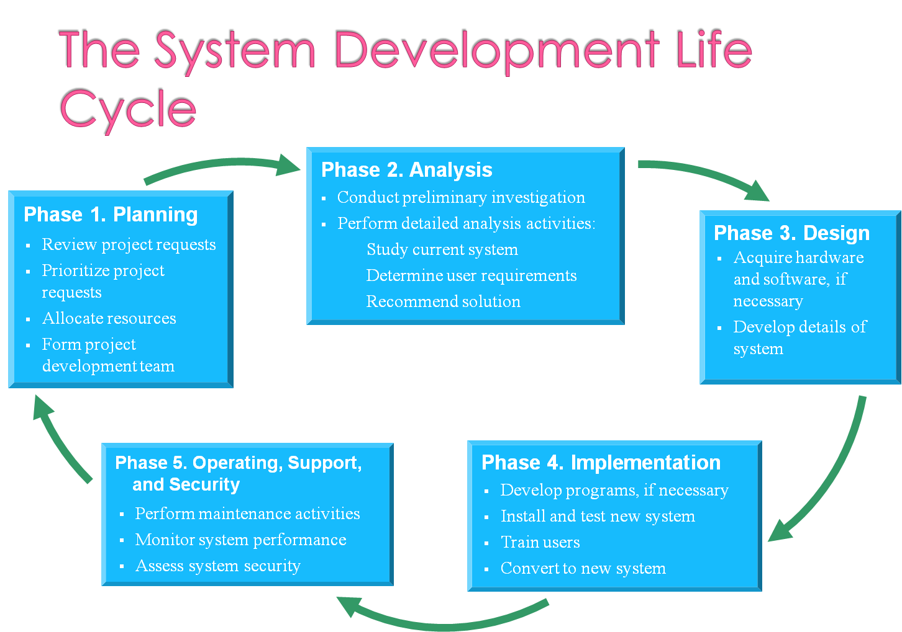

Slide 11
Database System Development Lifecycle
Database planning
System definition
Requirements collection and analysis
Database design
DBMS selection (optional)

Slide 12
Database System Development Lifecycle
Application design
Prototyping (optional)
Implementation
Data conversion and loading
Testing
Operational maintenance

Slide 13
Database Planning
Management activities that allow stages of database system development lifecycle to be realized as efficiently and effectively as possible.
Must be integrated with overall IS strategy of the organization.

Slide 14
Database Planning – Mission Statement
Mission statement for the database project defines major aims of database application.
Those driving database project normally define the mission statement.
Mission statement helps clarify purpose of the database project and provides clearer path towards the efficient and effective creation of required database system.

Slide 15
Examples-Objectives
Specific Objective of the Project: (Please describe the measurable general and specific objectives of the project and define the expected results. Use results-oriented wording with verbs such as ‘to define . . . ’, “to determine .‘, ‘to identify . . .’)
To provide training to IT/CS students keeping in view the requirements of their prospective employers (i.e. the software industry).
To allow students to learn good programming practices by reading professionally
written high-quality code and by getting feedback from professionals.
To address (and try to resolve) the issue of the scarcity of quality CS/SE faculty in most of the universities.
To help software industry by providing them with workforce who have worked on industrial strength projects, thus reducing the costs of training programs.

Slide 16
Database Planning
Database planning should also include development of standards that govern:
  how data will be collected,
  how the format should be specified,
  what necessary documentation will be needed,
  how design and implementation should proceed.

Slide 17
System Definition
Describes scope and boundaries of database system and the major user views.
User view defines what is required of a database system from perspective of:
  a particular job role (such as Manager or Supervisor) or
  enterprise application area (such as marketing, personnel, or stock control).

Slide 18
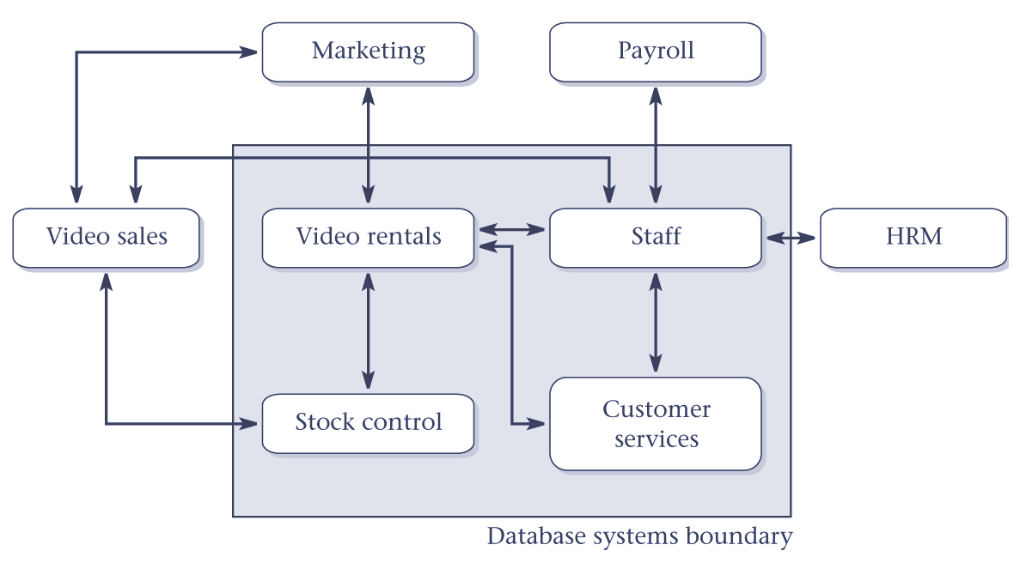
Boundary for database system of StayHome

Slide 19
System Definition
Database application may have one or more user views.
Identifying user views helps ensure that no major users of the database are forgotten when developing requirements for new system.
User views also help in development of complex database system allowing requirements to be broken down into manageable pieces.

Slide 20
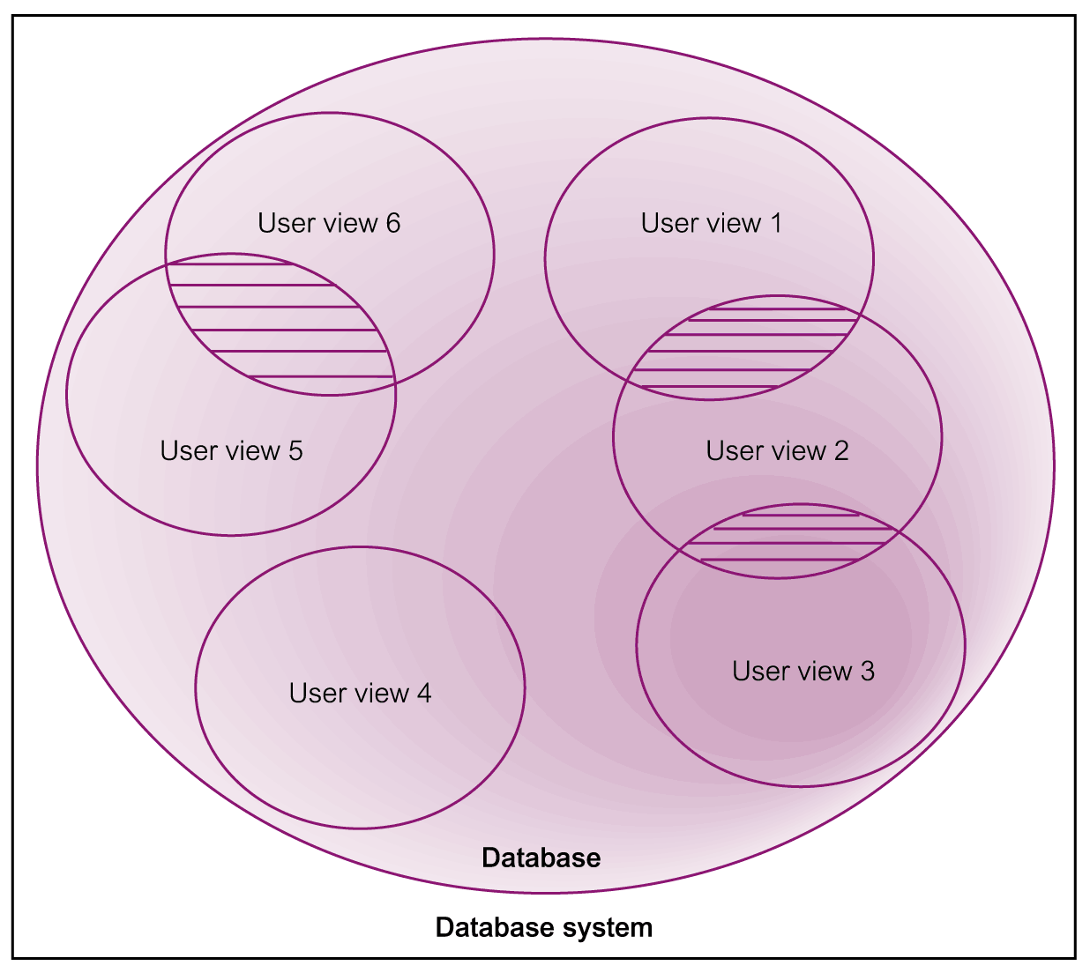
Representation of a Database System with Multiple User Views

Slide 21
Requirements Collection and Analysis
Process of collecting and analyzing information about the part of organization to be supported by the database system, and using this information to identify users’ requirements of new system.

Slide 22
Requirements Collection and Analysis
Information is gathered for each major user view including:
  a description of data used or generated;
  details of how data is to be used/generated;
  any additional requirements for new database system.
Information is analyzed to identify requirements to be included in new database system. Described in the requirements specification.

Slide 23
Requirements Collection and Analysis
Another important activity is deciding how to manage the requirements for a database system with multiple user views.
Three main approaches:
  centralized approach;
  view integration approach;
  combination of both approaches.

Slide 24
Requirements Collection and Analysis
Centralized approach
  Requirements for each user view are merged into a single set of requirements.
  A data model is created representing all user views during the database design stage.

Slide 25
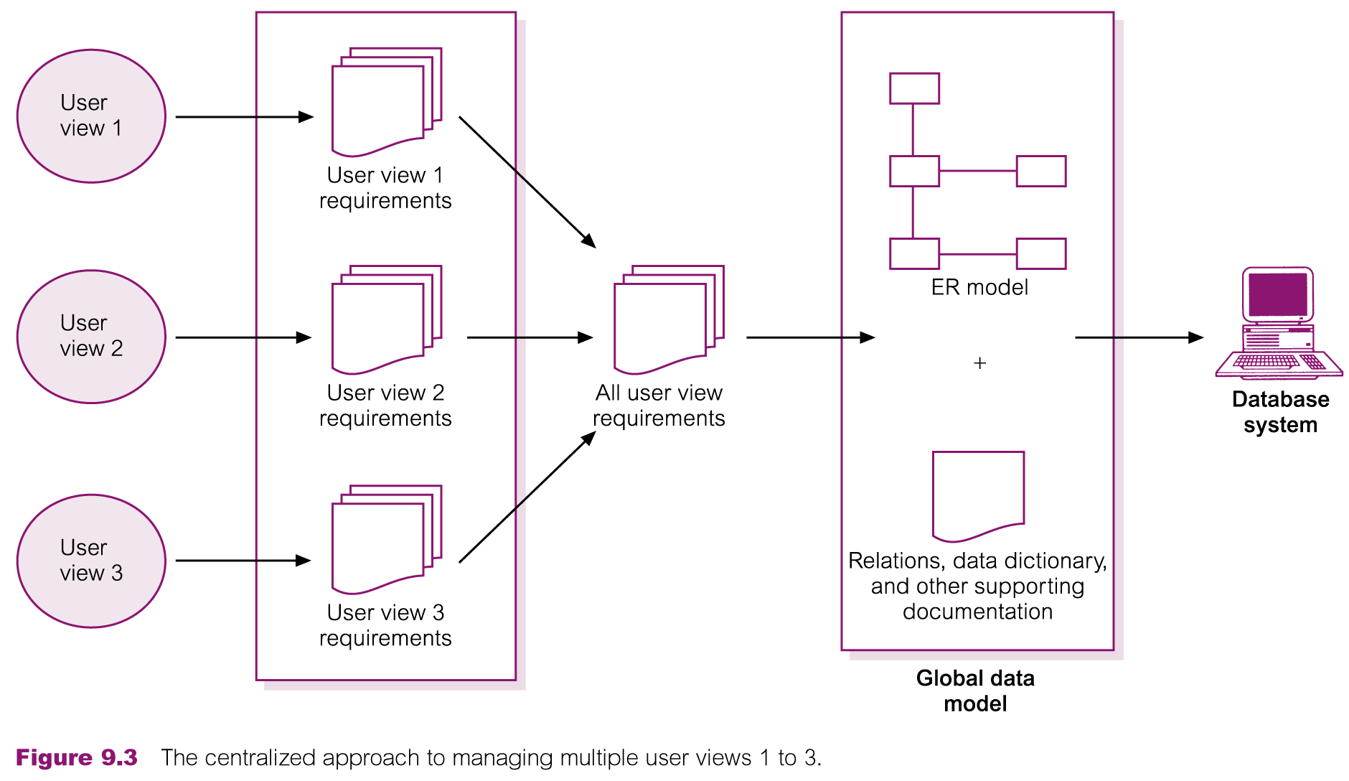
Centralized Approach to Managing Multiple User Views

Slide 26
Requirements Collection and Analysis
View integration approach
  Requirements for each user view remain as separate lists.
  Data models representing each user view are created and then merged later during the database design stage.

Slide 27
Requirements Collection and Analysis
Data model representing single user view (or a subset of all user views) is called a local data model.
Each model includes diagrams and documentation describing requirements for one or more but not all user views of database.

Slide 28
Requirements Collection and Analysis
Local data models are then merged at a later stage during database design to produce a global data model, which represents all user views for the database.

Slide 29
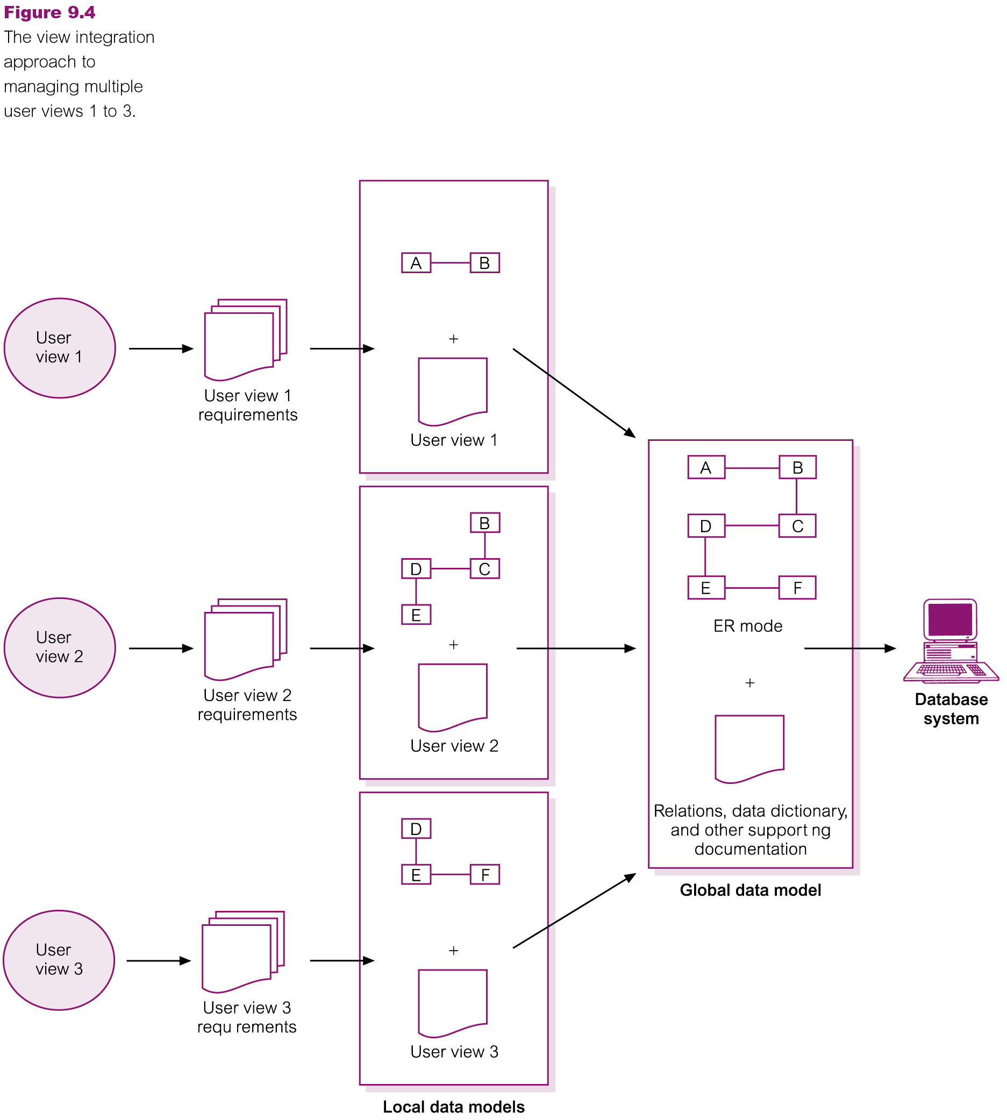
View Integration Approach to Managing Multiple User Views

